Slide 1

HR Analytics Project
Boosting Retention with Data Insights at Adecco India
Background: Addressing high turnover rates, especially among junior sales employees.

Slide 2
Company Background
Adecco India is a medium-sized technology company specializing in software development. It has a diverse workforce spread across various departments, including engineering, marketing, sales, and customer support

Slide 3
Problem Statement
What is the Problem?
High attrition rates disrupting productivity and increasing costs.
Importance of Solving This Problem
Addressing attrition will reduce costs, enhance productivity, and create a more stable workforce.

Slide 4
Stakeholders
Internal Stakeholders:
HR Department
Sales Department
Engineering Department
Marketing Department
Customer Support Department
Senior Management
External Stakeholders:
Recruitment Agencies
Training Providers

Slide 5
Data Requirements
HRIS
Performance Management System
Employee Surveys
Exit Interviews

Slide 6
Key Metrics
Attrition Rate
Job Satisfaction Score
Engagement Score
Performance Ratings
Tenure

Slide 7
Insights & Actions
Targeted Analysis: Analyzing historical data for factors contributing to attrition.
Actionable Insights: Developing strategies to improve retention and job satisfaction.

Slide 8
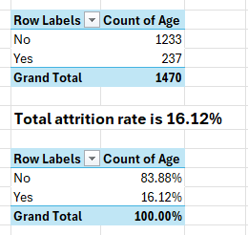
What is the overall attrition rate at Adecco India?

Slide 9
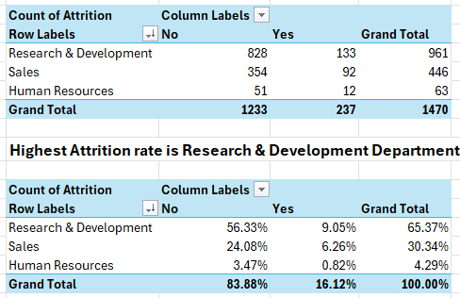
Which department has the highest attrition rate?

Slide 10
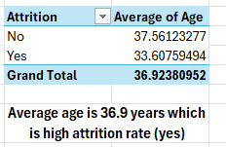
What is the average age of employees who have left the company?

Slide 11
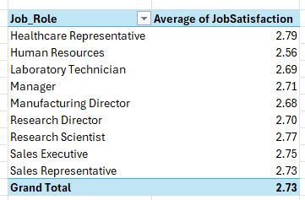
How does job satisfaction vary across different job roles?

Slide 12
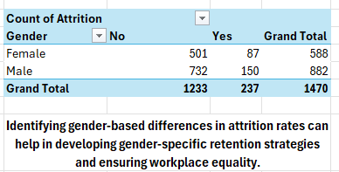
Is there a significant difference in attrition rates between male and female employees?

Slide 13
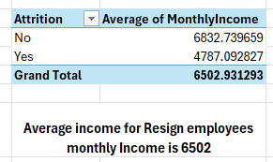
What is the average monthly income of employees who have left the company ?

Slide 14
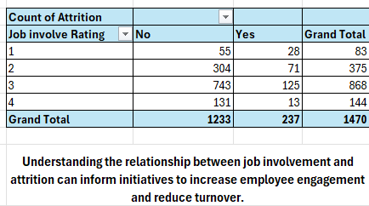
How does the attrition rate vary with different levels of job involvement?

Slide 15

Conclusion
Final Deliverables:
Case study, solution guide, and actionable insights for Adecco India.

Slide 16




Thank You !
For any suggestion feel free to ask any
Question
ravisingh152458@gmail.com
Linkedin
Dashboard
RAVI KUMAR

